Slide 1
8.4 Assemblers
2
Mnemonic instructions, such as LOAD 104, are easier for humans to write and understand than binary instructions..
The assembler translates instructions that are comprehensible to humans into binary for the CPU to interpret.
The assembler creates executable software compatible with the operating system and available hardware.

Slide 2
4.11 Assemblers
42
Assemblers create an object program file from mnemonic source code in two passes.
During the first pass, the assembler assembles as much of the program as it can, while it builds a symbol table that contains memory references for all symbols in the program.
During the second pass, the instructions are completed using the values from the symbol table.

Slide 3
4.11 Assemblers
42a
Two passes are needed to handle forward references.
  Suppose your program contains B BLOB, where BLOB is an address that occurs after the branch statement.
  How can the assembler know the absolute address of BLOB, i.e., how can it know how many bytes will occur between the branch statement and the label BLOB?
  On the first pass, the assembler adds the label BLOB to the symbol table. It puts zeros in the address field of the code being assembled for the branch statement, i.e., it leaves the address unresolved.
  Code: Symbol table:
  0123 B 0x0000 // go to BLOB BLOB 0x0000
  ...
  ???? BLOB: ...

Slide 4
4.11 Assemblers
42b
References are resolved during the second pass.
  When the assembler gets to the label BLOB, it now knows what address to assign, so it puts that address in the symbol table.
  On the second pass, it looks up all unresolved references and replaces the zeros with the correct address.
  Code: Symbol table:
  0123 B 0x0196 BLOB 0x0196
  ...
  0196 BLOB: ...
The linker resolves references between object modules, e.g., when one program calls another.
  After resolving references, it combines the individual object modules into one executable.

Slide 5
4.11 Assemblers
42c
The program on slide 43 shows two enhancements to the assembler language.
  We can use labels like X, Y and Z instead of absolute or relative hex addresses.
  We can use directives, like DEC or HEX, when defining constants. The use of DEC is just for convenience; the assembler will assign the same hex values regardless of how we write our constants.
These enhancements are independent.
  We could have labels but still need to write constants in hex.

Slide 6
4.11 Assemblers
42d
Enhancements to the assembler language are different from enhancements to the instruction set.
  Enhancements to the instruction set can only happen if the machine architecture is extended to handle the additional instructions.

Slide 7
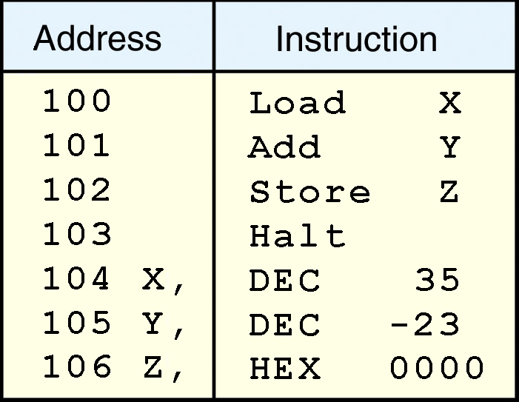
4.11 Assemblers
43
Here is another example of using the symbol table is to resolve references to forward data items, such as X, Y and Z in this code.

Slide 8
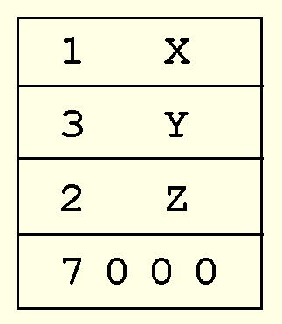
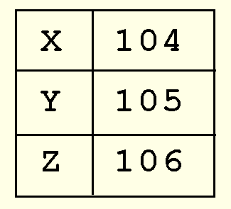
4.11 Assemblers
43b
During the first pass, we know that LOAD will generate op code ‘1’, but we don’t know the address of X yet.
For HALT, we can generate the entire instruction because it has no addresses to resolve.
When we get to X (see next slide), we can see that its address will be 104.
Code in process ->
(1 = LOAD but we don’t know the value of X yet)
??
Symbol table in -> process
??
??

Slide 9
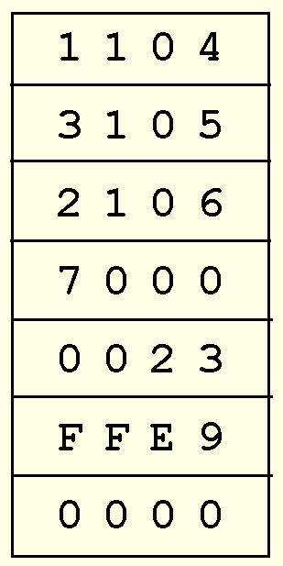
4.11 Assemblers
44
In the second pass, we fill in addresses for X, Y and Z.
  Since you can see the full code now, you can also see that the data items have been converted to hex in 2’s complement form.

Slide 10
8.4 Assemblers
44b
The output of most assemblers is a stream of relocatable binary code.
  In relocatable code, operand addresses are relative to where the operating system chooses to load the program.
  Absolute (nonrelocatable) code is most suitable for device and operating system control programming.
When relocatable code is loaded for execution, special registers provide the base address.
Addresses specified within the program are interpreted as offsets from the base address.

